Slide 1
Binary Arithmetic
Addition, Subtraction and Multiplication

Slide 2
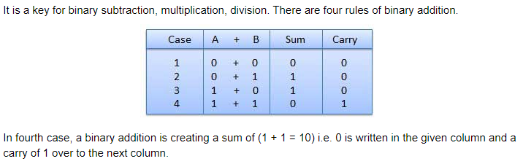
Binary Addition Rule

Slide 3
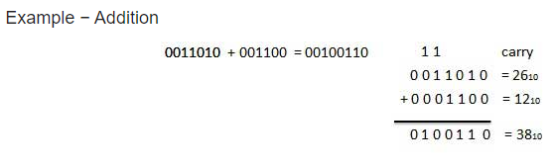
Binary Addition Rule

Slide 4
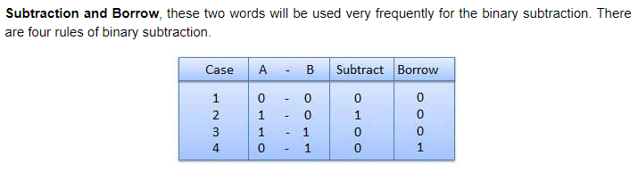
Binary Subtraction Rule

Slide 5
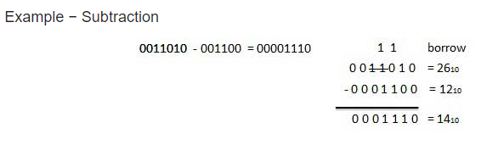
Binary Subtraction Rule

Slide 6
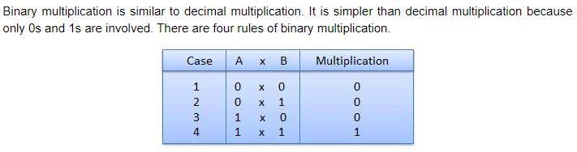
Binary Multiplication Rule

Slide 7
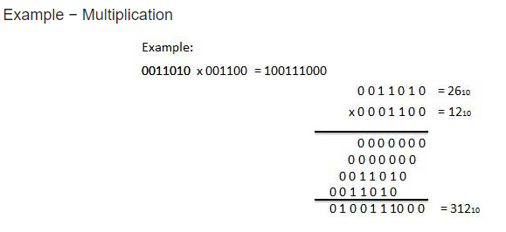
Binary Multiplication Rule

